Slide 1

Wel come

Slide 2
IDENTITY
Mohammad Abul Hossain
Assistant teacher(English)
Ghagotia Chala High school.
Kapasia,Gazipur
Subject-English 1^{st paper}
Class-8
Unit-9
Lesson-01
Time-50minutes
Date-19-2-2014

Slide 3
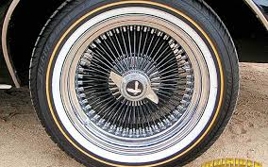
.pp

Slide 4
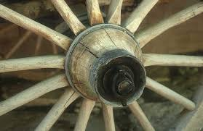
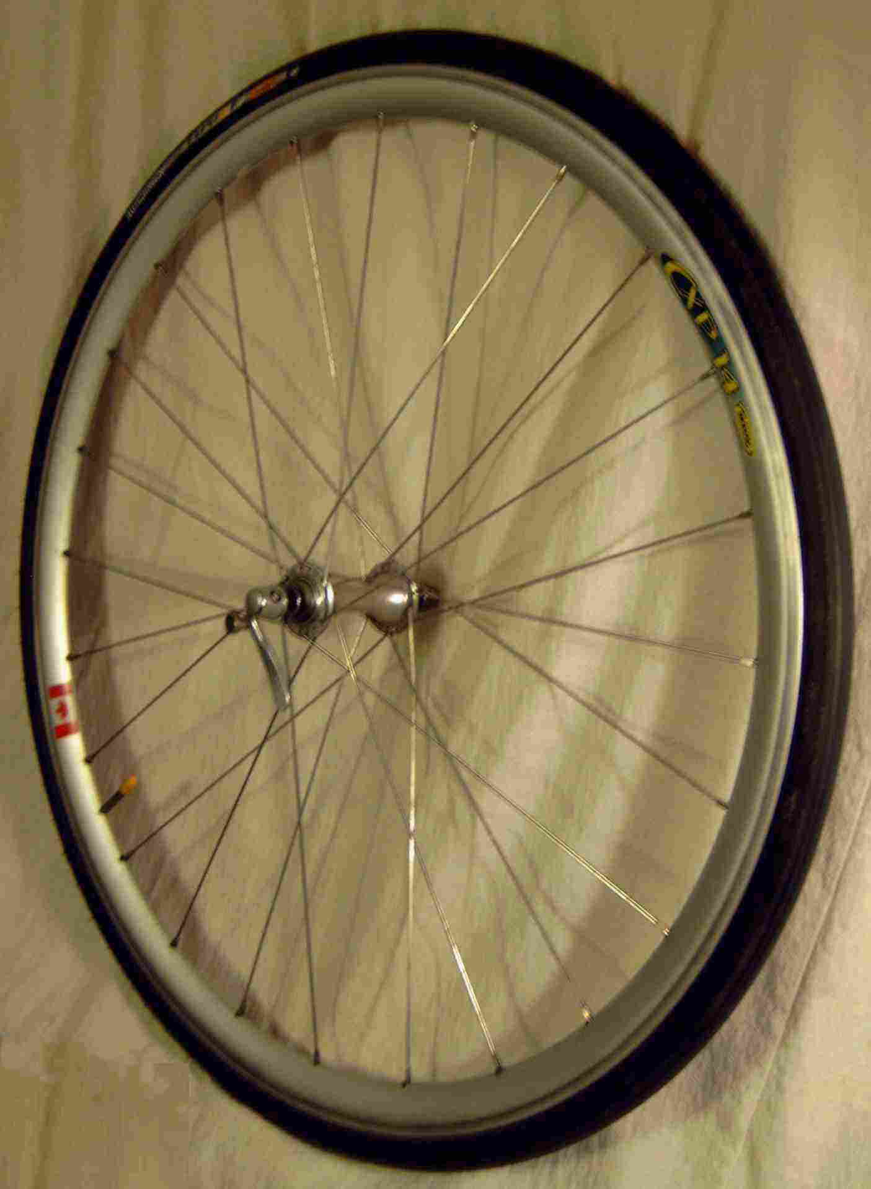
o

Slide 5
LEARNING OUTCOMES
After reading this lesson the ss will be able to learn……………………………………………..
To describe wheel.
To uses of wheel.
To importance of wheel

Slide 6
THE WHEEL
The defenation of wheel
Different kinds of wheel
Uses of wheel

Slide 7
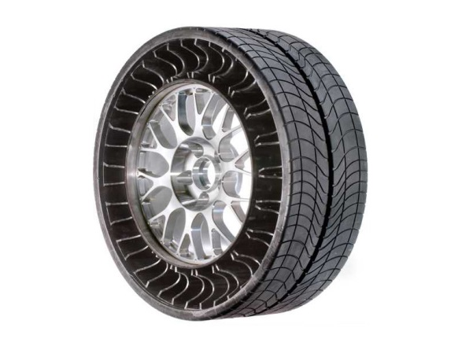
PAIR WORK
Look at the pictures of wheel and they will say which is easier to move and why.

Slide 8
INDIVIDUAL WORK
What is wheel?
What can a wheel do?
Where can you find wheel?

Slide 9
GROUP WORK
Make as many correct sentences as you can using the substitution table..
1,The wheel
2.A plain wheel
3.It
4,A propeller
Is
Has
rotates
A type of wheel.
Around its axis.
One of the simplest machine.
Wheel on vehicles and machines.
Helped in rapid progress of civilisation.

Slide 10
HOME WORK
Have you ever travelled by bus or car ?Do you have any experience of what happens if one
Wheel falls flat.if yes ,give a description of your experience.if no,imagine such a situation, and
Write a paragraph on it.

Slide 11

.
THANK YOU

